Slide 1
PRACTICLE SESSION
Do your best, then call for help

Slide 2
Tables
Products
Categories
Orders

Slide 3
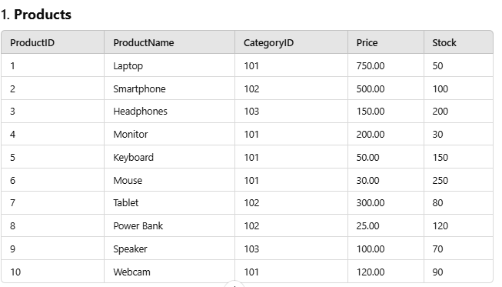
Products Table Structure

Slide 4
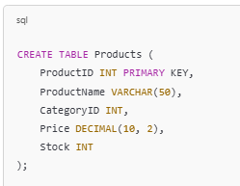
Product Table Set Up

Slide 5
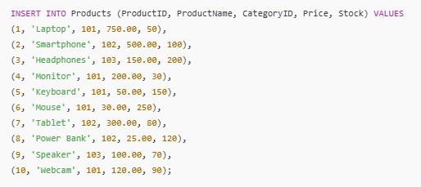
Product Table Values

Slide 6
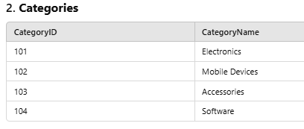
Categories Table Structure

Slide 7

Categories Table Set Up

Slide 8
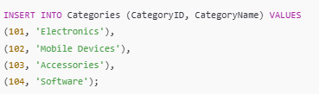
Categories Table Values

Slide 9
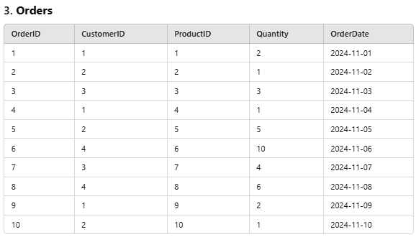
Orders Table Structure

Slide 10
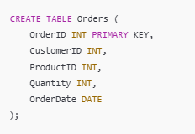
Order Table Set Up

Slide 11
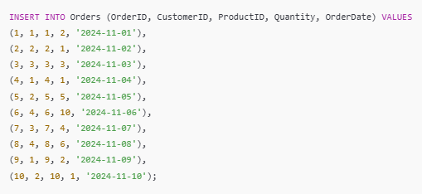
Order Table Values

Slide 12
TASKS
Time to learn

Slide 13
Task 1: Filtering Records
Write a query to retrieve all products priced above 100.00.
Write a query to find all products in the "Electronics" category.

Slide 14
Task 2: Using Joins
Use an INNER JOIN to list all product names along with their category names.
Use a LEFT JOIN to list all categories and their products, including categories without products.

Slide 15
Task 3: Date Functions
Find all orders placed in November 2024 using the MONTH() function.
Calculate the difference in days between today’s date and each order’s OrderDate using the DATEDIFF() function.

Slide 16
Task 4: Aggregation
Write a query to find the total stock available for all products.
Find the total quantity of each product ordered using GROUP BY.

Slide 17
Task 5: Subqueries
Write a query to find the product with the highest price.
Find the name of the category with the most products.

Slide 18
Task 6: Character Functions
Use the CONCAT() function to display the product name and price in the format: ProductName: $Price.
Use the LCASE() function to display all product names in lowercase.

